Slide 1
Project Presentation
TEMPERATURE AND LIGHT INTENSITY SENSOR
Based on IoT
Group Members
Fahad Hussain(CT-062)
S. Abu Owais Bin Nasar (CT-049)
Beenish Anwar(CT-048)
Shahzaib Ahmed(CT-056)
Taukeer Jalal(CT-037)
Osama Muslim (CT-059)
NED UNIVERSITY OF ENGINEERING AND TECHNOLOGY
Computer Science Department MS( CSIT)

Slide 2
AWS IoT Services
AWS IoT Core
AWS IoT Device Management
AWS Greengrass
AWS IoT Analytics
Amazon FreeRTOS
AWS IoT 1-Click
AWS IoT Button
AWS IoT Device Defender

Slide 3
AWS IOT Core
AWS IoT Core is a managed cloud platform that lets connected devices easily and securely interact with cloud applications and other devices. AWS IoT Core can support billions of devices and trillions of messages, and can process and route those messages to AWS endpoints and to other devices reliably and securely. With AWS IoT Core, your applications can keep track of and communicate with all your devices, all the time, even when they aren’t connected.
AWS IoT Core makes it easy to use AWS services like AWS Lambda, Amazon Kinesis, Amazon S3, Amazon Machine Learning, Amazon DynamoDB, Amazon CloudWatch, AWS CloudTrail, and Amazon Elasticsearch Service with built-in Kibana integration, to build IoT applications that gather, process, analyze and act on data generated by connected devices, without having to manage any infrastructure.
CONNECT AND MANAGE YOUR DEVICES
SECURE DEVICE CONNECTIONS AND DATA
PROCESS AND ACT UPON DEVICE DATA
READ AND SET DEVICE STATE AT ANY TIME

Slide 4
AWS IoT Device Management
AWS IoT Device Management makes it easy to securely onboard, organize, monitor, and remotely manage IoT devices at scale. IoT Device Management lets you register your devices individually or in bulk, and manage permissions so that devices remain secure. Then, you use the IoT Device Management console to organize your devices into groups, monitor and troubleshoot device functionality, and send remote updates to your devices. AWS IoT Device Management allows you to scale your device fleets and reduce the cost and effort of managing large IoT device deployments.
Fast Device Onboarding
Simple Device Organization
Locate Devices Quickly
Easy Remote Management

Slide 5
AWS Green Grass
AWS Greengrass is software that lets you run local compute, messaging, data caching, sync, and ML inference capabilities for connected devices in a secure way. With AWS Greengrass, connected devices can run AWS Lambda functions, keep device data in sync, and communicate with other devices securely – even when not connected to the Internet. Using AWS Lambda, Greengrass ensures your IoT devices can respond quickly to local events, use Lambda functions running on Greengrass Core to interact with local resources, operate with intermittent connections, stay updated with over the air updates, and minimize the cost of transmitting IoT data to the cloud.

Slide 6
Amazon FreeRTOS
Amazon FreeRTOS (a:FreeRTOS) is an operating system for microcontrollers that makes small, low-power edge devices easy to program, deploy, secure, connect, and manage. Amazon FreeRTOS is based on the FreeRTOS kernel, a popular open source operating system for microcontrollers, and extends it with software libraries that make it easy to securely connect your small, low-power devices to AWS cloud services like AWS IoT Core or to more powerful edge devices running AWS Greengrass.

Slide 7
AWS IoT 1-Click
AWS IoT 1-Click is a service that makes it easy for simple devices to trigger AWS Lambda functions that execute a specific action. Some examples of possible actions include calling technical support, reordering goods and services, or locking and unlocking doors and windows. Simple devices are cloud-connected, single-purpose devices like buttons, badge readers, asset trackers, and motion sensors. The AWS IoT Enterprise Button, based on the Amazon Dash Button hardware, is a simple device that you can buy and use with the AWS IoT 1-Click service. You can use the AWS IoT Enterprise Button to capture quick customer feedback without burdening customers with time-consuming questionnaires. For example, in an airport lounge, patrons can press one of five buttons to rate their overall experience on a scale from one to five.

Slide 8
AWS IoT Button
The AWS IoT Button is a programmable button based on the Amazon Dash Button hardware. This simple Wi-Fi device is easy to configure and designed for developers to get started with AWS IoT Core, AWS Lambda, Amazon DynamoDB, Amazon SNS, and many other Amazon Web Services without writing device-specific code.

Slide 9
You can code the button's logic in the cloud to configure button clicks to count or track items, call or alert someone, start or stop something, order services, or even provide feedback. For example, you can click the button to unlock or start a car, open your garage door, call a cab, call your spouse or a customer service representative, track the use of common household chores, medications or products, or remotely control your home appliances.

Slide 10
AWS IoT Device Defender
AWS IoT Device Defender is a fully managed service that helps you secure your fleet of IoT devices. AWS IoT Device Defender continuously audits the security policies associated with your devices to make sure that they aren’t deviating from security best practices. A security policy is a set of technical controls that devices follow to help keep information secure when communicating with other devices and the cloud. AWS IoT Device Defender makes it easy to maintain and enforce security policies, such as ensuring device identity, authenticating and authorizing devices, and encrypting device data. AWS IoT Device Defender continuously audits the security policies on your devices against a set of predefined security best practices. AWS IoT Device Defender sends an alert if there are any gaps in your policies that might create a security risk, such as identity certificates being shared across multiple devices or a device with a revoked identity certificate trying to connect to AWS IoT Core.

Slide 11
AWS IoT Device Defender also lets you monitor devices for behavior that deviates from what you have defined as appropriate behavior for each device. Then, if something doesn’t look right, AWS IoT Device Defender sends out an alert so you can take action to remediate the issue. For example, traffic spikes in outbound traffic might indicate that a device is participating in a DDoS attack.
AWS IoT Device Defender can send alerts to the AWS IoT Console, Amazon CloudWatch, and Amazon SNS. If you determine that you need to take an action based on an alert, you can use the AWS IoT Device Management service to take mitigating actions such as pushing security fixes.

Slide 12
How AWS IoT Works
AWS IoT enables Internet-connected devices to connect to the AWS Cloud and lets applications in the cloud interact with Internet-connected devices. Common IoT applications either collect and process telemetry from devices or enable users to control a device remotely.
AWS IoT provides secure, bi-directional communication between Internet-connected devices such as sensors, actuators, embedded micro-controllers, or smart appliances and the AWS Cloud. This enables you to collect telemetry data from multiple devices, and store and analyze the data. You can also create applications that enable your users to control these devices from their phones or tablets.

Slide 13
AWS IoT Components
AWS IoT SDKs The AWS IoT Device SDKs help you to easily and quickly connect your devices to AWS IoT. The AWS IoT Device SDKs include open-source libraries, developer guides with samples, and porting guides so that you can build innovative IoT products or solutions on your choice of hardware platforms.
Device gateway The Device Gateway serves as the entry point for IoT devices connecting to AWS. The Device Gateway manages all active device connections and implements semantics for multiple protocols to ensure that devices are able to securely and efficiently communicate with AWS IoT Core. Currently the Device Gateway supports the MQTT, WebSockets, and HTTP 1.1 protocols. For devices that connect using MQTT or WebSockets the Device Gateway will maintain long lived, bidirectional connections,enabling these devices to send and receive messages at any time with low latency

Slide 14
AWS IoT Components
Message broker The Message Broker is a high throughput pub/sub message broker that securely transmits messages to and from all of your IoT devices and applications with low latency. Provides a secure mechanism for devices and AWS IoT applications to publish and receive messages from each other. You can use either the MQTT protocol directly or MQTT over WebSocket to publish and subscribe. You can use the HTTP REST interface to publish.
Rules engine Provides message processing and integration with other AWS services. You can use an SQL-based language to select data from message payloads, and then process and send the data to other services, such as Amazon S3, Amazon DynamoDB, and AWS Lambda. You can also use the message broker to republish messages to other subscribers.

Slide 15
AWS IoT Components
Security and Identity service Provides shared responsibility for security in the AWS Cloud. Your devices must keep their credentials safe in order to securely send data to the message broker. The message broker and rules engine use AWS security features to send data securely to devices or other AWS services.
REGISTRY The Registry establishes an identity for devices and tracks metadata such as the devices’ attributes and capabilities. The Registry assigns a unique identity to each device that is consistently formatted regardless of the type of device or how it connects.
Device shadow A JSON document used to store and retrieve current state information for a device. Provides persistent representations of your devices in the AWS Cloud. You can publish updated state information to a device's shadow, and your device can synchronize its state when it connects. Your devices can also publish their current state to a shadow for use by applications or other devices.

Slide 16
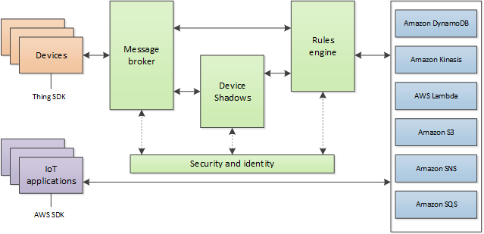
AWS IoT Components

Slide 17
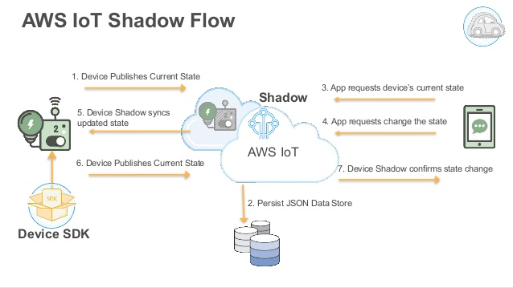
Device Shadow Flow

Slide 18
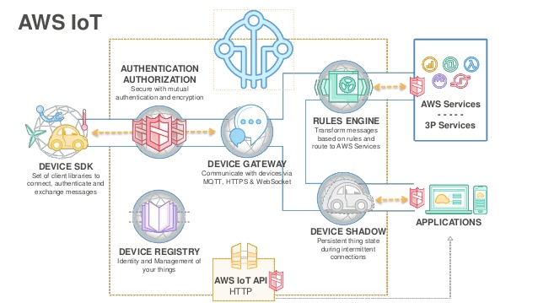
AWS IoT Security: Authentication and Authorization

Slide 19
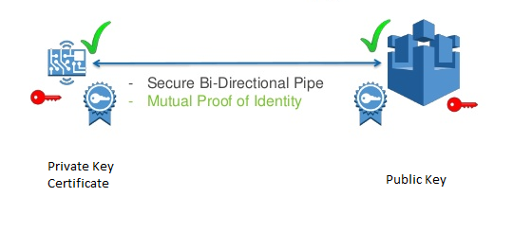
Security – IoT Requirements
Strong Authentication
Secure Communication

Slide 20
Proceed With AWS
Register Device
e.g. ARN
2. Create Certificate
e.g. Public Key
Private Key
Certificate
CA
Create Policy
e.g. Publisher
Subscriber

Slide 21
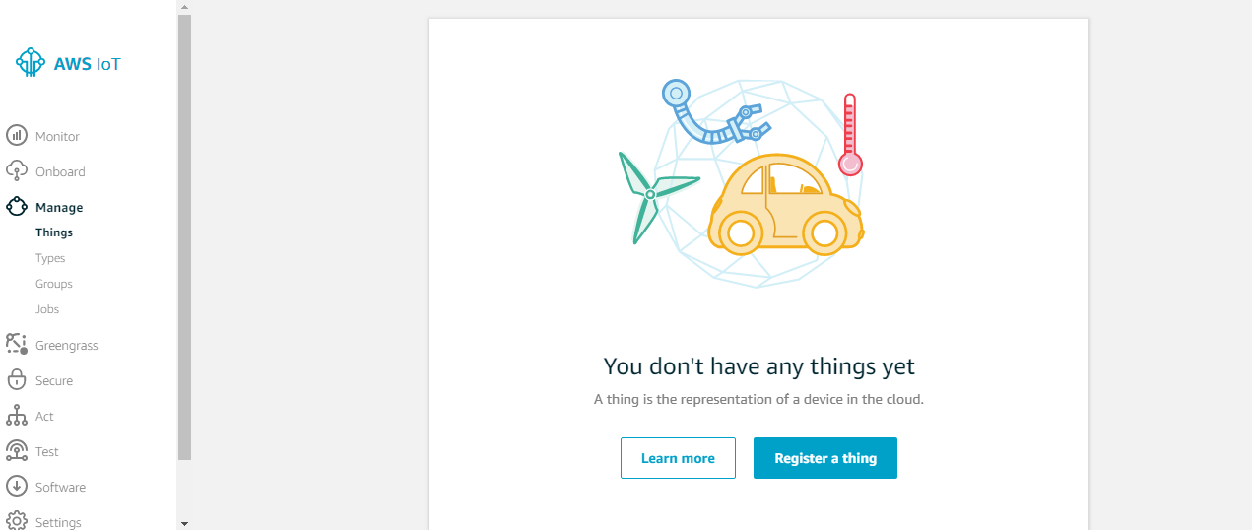
Register Device
Click on AWS Service – Internet Of Things – IoT Device Management

Slide 22
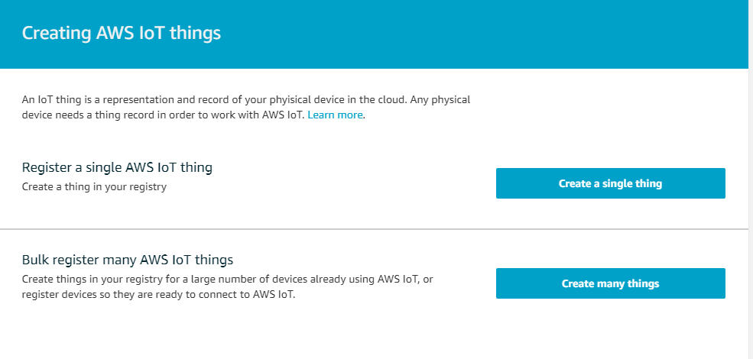
Register Device

Slide 23
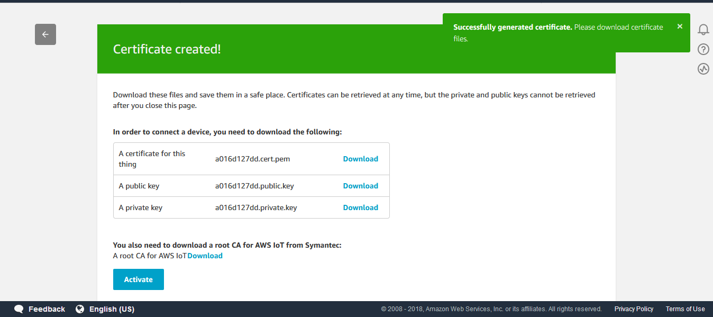
Certificates

Slide 24
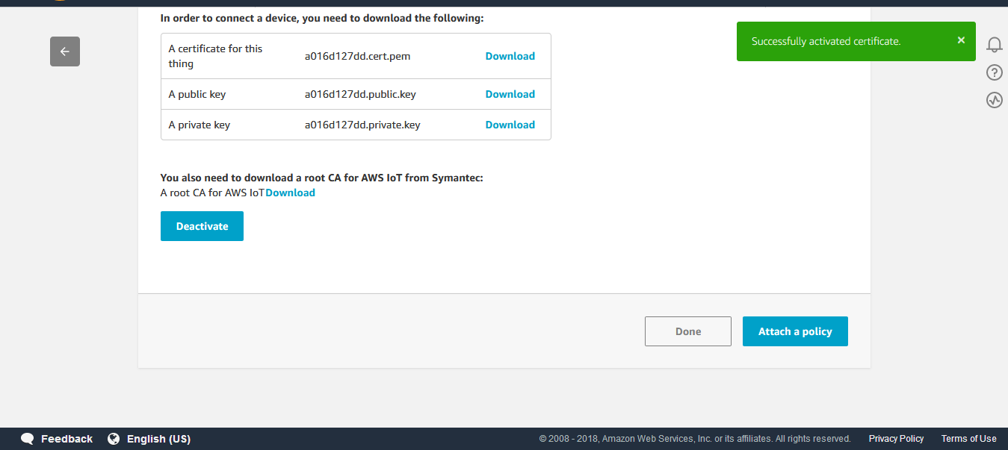
Certificates

Slide 25
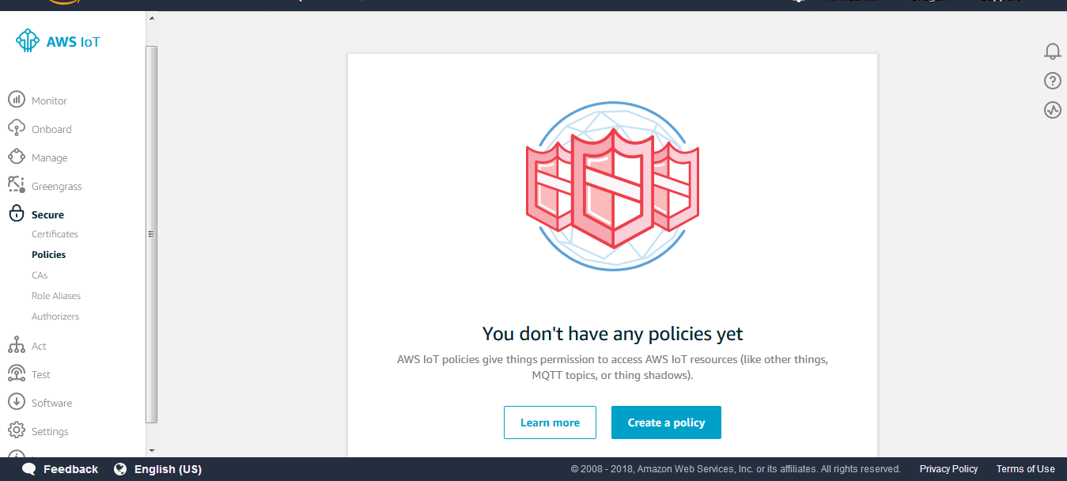
Policies

Slide 26
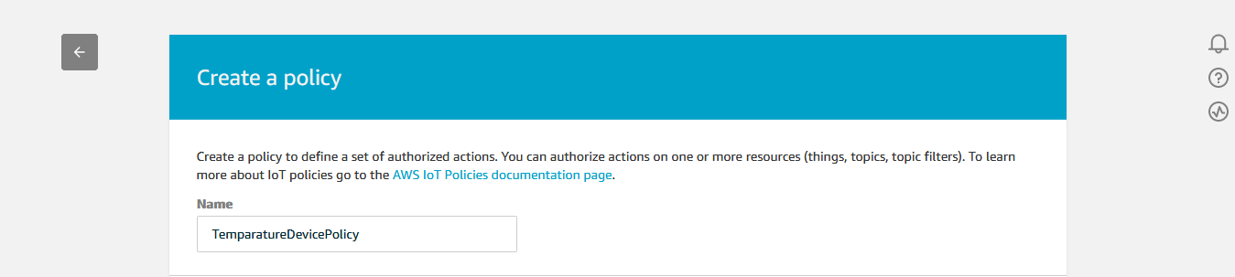
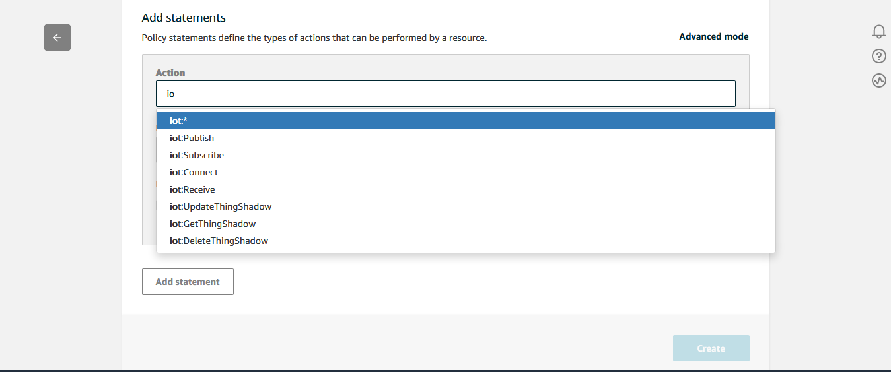
Policies

Slide 27
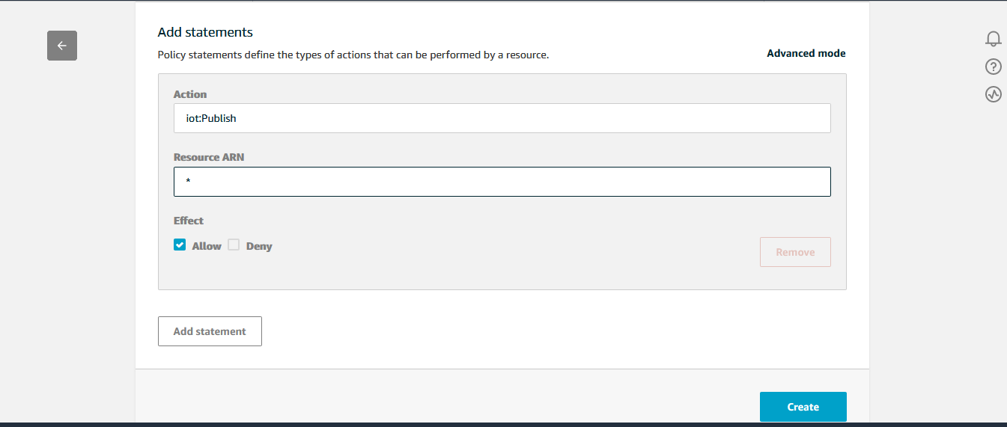
Policies

Slide 28
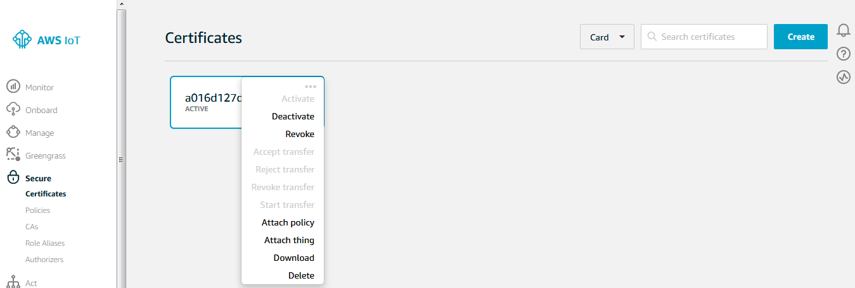
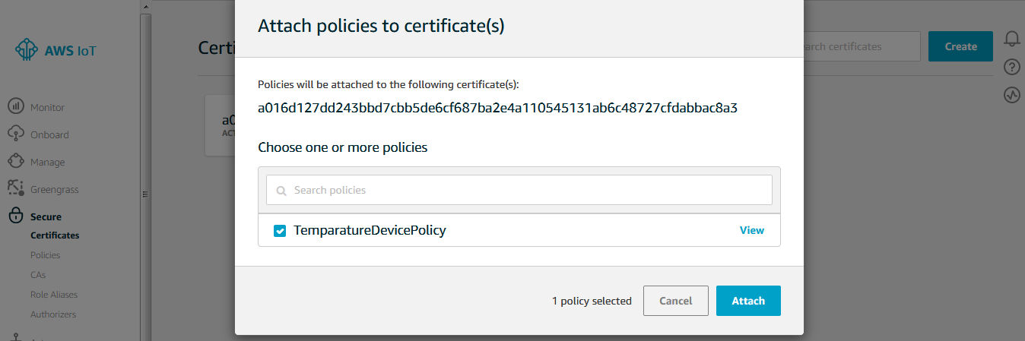
Attached Certificate With Thing And Policy

Slide 29
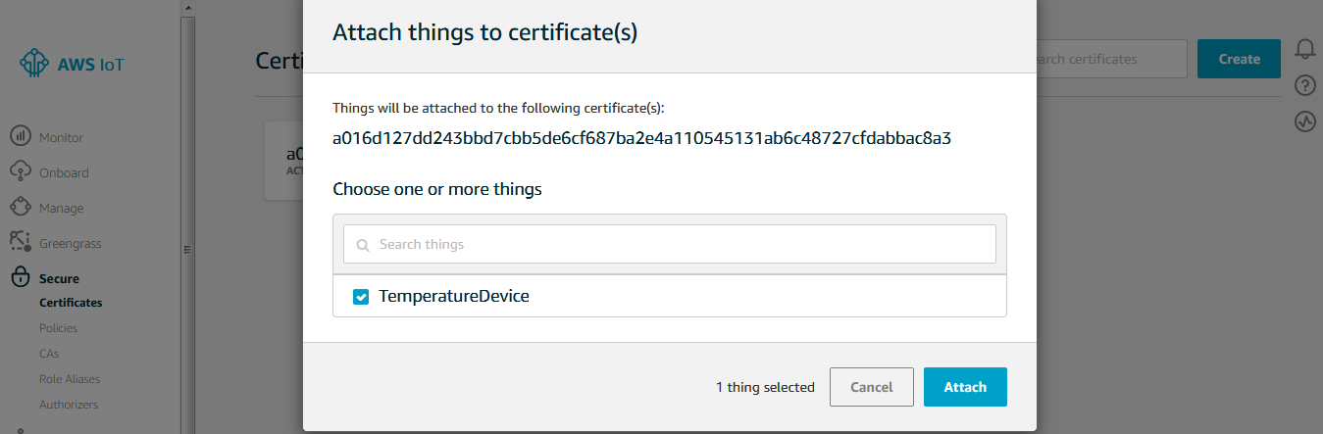
Attached Certificate With Thing And Policy

Slide 30
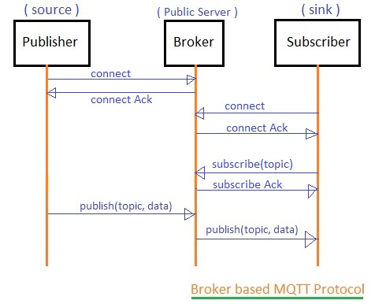
Paho MQTT
MQTT (Message Queuing Telemetry Transport) is an ISO standard (ISO/IEC PRF 20922) publish-subscribe-based messaging protocol. It works on top of the TCP/IP protocol. It is designed for connections with remote locations where a "small code footprint" is required or the network bandwidth is limited.
pip install paho-mqtt
Notes:
30

Slide 31
Publish.py
import paho.mqtt.client as paho
import os
import socket
import ssl
from time import sleep
from random import uniform
connflag = False
def on_connect(client, userdata, flags, rc):
global connflag
connflag = True
print("Connection returned result: " + str(rc) )
def on_message(client, userdata, msg):
print(msg.topic+" "+str(msg.payload))
mqttc = paho.Client()
mqttc.on_connect = on_connect
mqttc.on_message = on_message
Notes:
31

Slide 32
Publish.py (contd.)
awshost = "a1t7wpltysp7gc.iot.us-east-2.amazonaws.com"
awsport = 8883
clientId = "Iot1"
thingName = "Iot1"
caPath = 'VeriSign-Class 3-Public-Primary-Certification-Authority-G5.pem.txt'
certPath = 'abeeb26700-certificate.pem.crt'
keyPath = 'abeeb26700-private.pem.key'
mqttc.tls_set(caPath, certfile=certPath, keyfile=keyPath, cert_reqs=ssl.CERT_REQUIRED, tls_version=ssl.PROTOCOL_TLSv1_2, ciphers=None)
mqttc.connect(awshost, awsport, keepalive=60)
mqttc.loop_start()
for i in range(50):
sleep(0.5)
if connflag == True:
topic = input("Please enter iot code to publish:\n")
message = input("Please write message to publish:\n")
mqttc.publish(topic, message, qos=1)
print("\nmsg sent")
else:
print("waiting for connection...")
Notes:
32

Slide 33
Subcribe.py
import paho.mqtt.client as paho
import os
import socket
import ssl
def on_connect(client, userdata, flags, rc):
print("Connection returned result: " + str(rc) )
# Subscribing in on_connect() means that if we lose the connection and
# reconnect then subscriptions will be renewed.
client.subscribe("#" , 1 )
def on_message(client, userdata, msg):
print("topic: "+msg.topic)
print("payload: "+str(msg.payload))
mqttc = paho.Client()
mqttc.on_connect = on_connect
mqttc.on_message = on_message
Notes:
33

Slide 34
Subcribe.py (contd.)
awshost = "a1t7wpltysp7gc.iot.us-east-2.amazonaws.com"
awsport = 8883
clientId = "Iot1"
thingName = "Iot1"
caPath = 'VeriSign-Class 3-Public-Primary-Certification-Authority-G5.pem.txt'
certPath = 'abeeb26700-certificate.pem.crt'
keyPath = 'abeeb26700-private.pem.key'
mqttc.tls_set(caPath, certfile=certPath, keyfile=keyPath, cert_reqs=ssl.CERT_REQUIRED, tls_version=ssl.PROTOCOL_TLSv1_2, ciphers=None)
mqttc.connect(awshost, awsport, keepalive=60)
mqttc.loop_forever()
Notes:
34

Slide 35
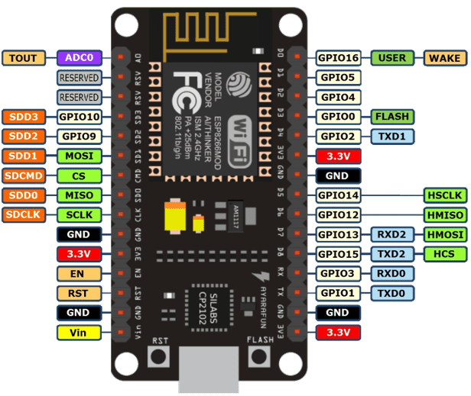
Node mcu (ESP8266)
8 Digital read/writepins to turn any switch on or off
1 ADC for analog read, temperature, voltage, humidity, intensity etc
RX TX for serial communication.
PWM (pulse width modulation), for controlling speed of motors or power output of heating elements
I2C communication an intra on board controller communication protocole
cost: $5 - $6

Slide 36
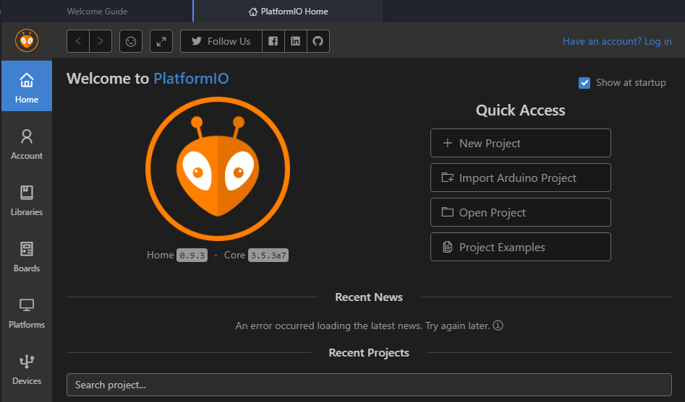
IoT development IDE Plateform IO

Slide 37
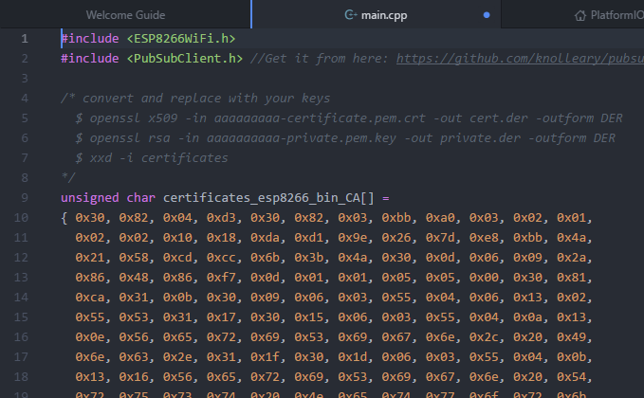
C++ libraries used

Slide 38

Program

Slide 39
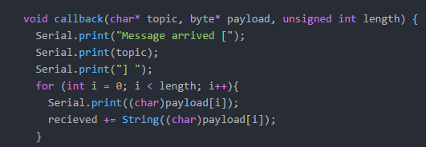
Subscription function

Slide 40
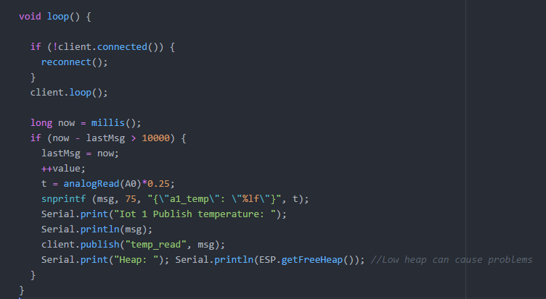
Publishing loop function

Slide 41
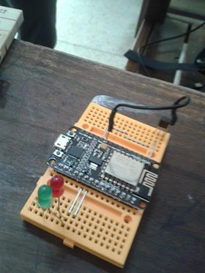
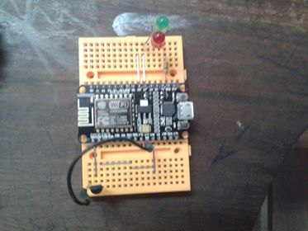
CIRCUIT

Slide 42
Thank You

